Slide 1
Dedicated short-range communications (DSRC)

Slide 2
AGENDA
Introduction to DSRC
DSRC standards
Physical layer standards
Data layer standards
DSRC applications
Advantages of DSRC
Challenges and limitations of DSRC
Future of DSRC

Slide 3
Introduction to DSRC

Slide 4
Definition of DSRC
DSRC is a wireless communication technology that operates in the 5.9 GHz frequency band and is used for vehicle-to-vehicle (V2V) and vehicle-to-infrastructure (V2I) communications.

Slide 5
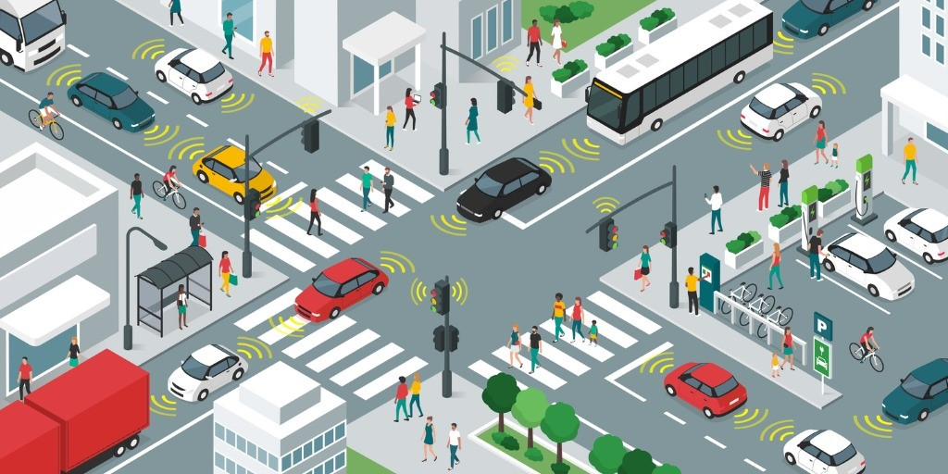

Slide 6
History
In October 1999, the United States Federal Communications Commission (FCC) allocated 75 MHz of spectrum in the 5.9 GHz band to be used by intelligent transportation systems (ITS).
In August 2008, the European Telecommunications Standards Institute (ETSI) allocated 30 MHz of spectrum in the 5.9 GHz band for ITS.
By 2003, it was used in Europe and Japan in electronic toll collection. DSRC systems in Europe, Japan and the U.S. are not compatible and include some very significant variations (5.8 GHz, 5.9 GHz or even infrared, different baud rates, and different protocols).
In June 2017, the Utah Department of Transportation successfully demonstrated a Transit DSRC system on SR-68 (Redwood Road) for eleven miles, from 400 South in Salt Lake City to 8020 South in West Jordan City.
In November 2020, the FCC reallocated all of DSRC's spectrum for other uses citing lack of adoption.
In October 1999, the United States Federal Communications Commission (FCC) allocated 75 MHz of spectrum in the 5.9 GHz band to be used by intelligent transportation systems (ITS).

Slide 7
Frequency band and range
DSRC uses the 5.9 GHz frequency band, which is dedicated for ITS applications. The range of DSRC depends on the transmit power, antenna gain, and other factors, but it is typically about 1000 meters.

Slide 8
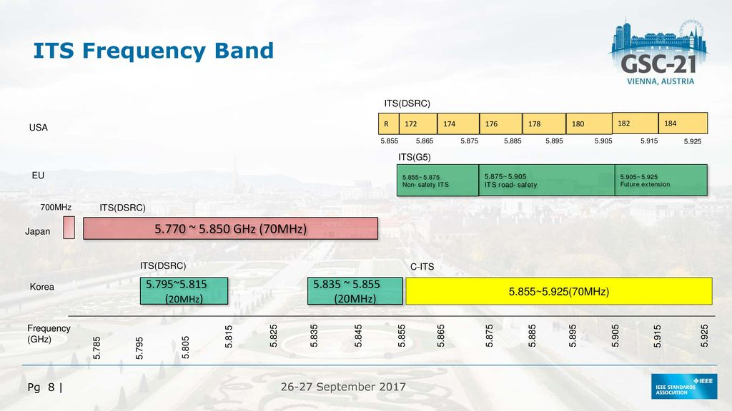

Slide 9
Applications in ITS
DSRC can be used for a variety of ITS applications, such as, Emergency warning system for vehicles, Cooperative Adaptive Cruise Control, Cooperative Forward Collision Warning, Intersection collision avoidance, Approaching emergency vehicle warning (Blue Waves), Vehicle safety inspection, Transit or emergency vehicle signal priority, Electronic parking payments.

Slide 10
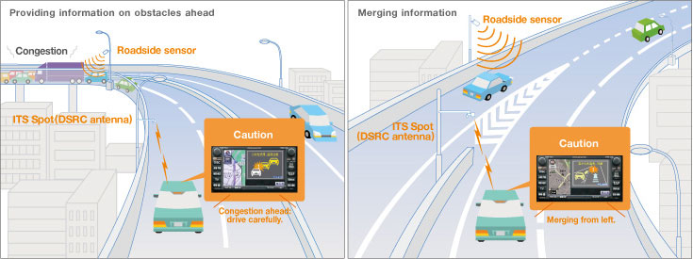

Slide 11
Problems
Safety
Car accidents cause to:
20 - 50 Million injuries,
1.2 Million deaths every year all around the World.
Mobility
As a result of traffic, there is a huge wasted time for almost every person on the World.
Cost
Car accident cost to 518 Billion Dolar every year.
Enviroment
3 Billion gallons of wasted fuel.

Slide 12
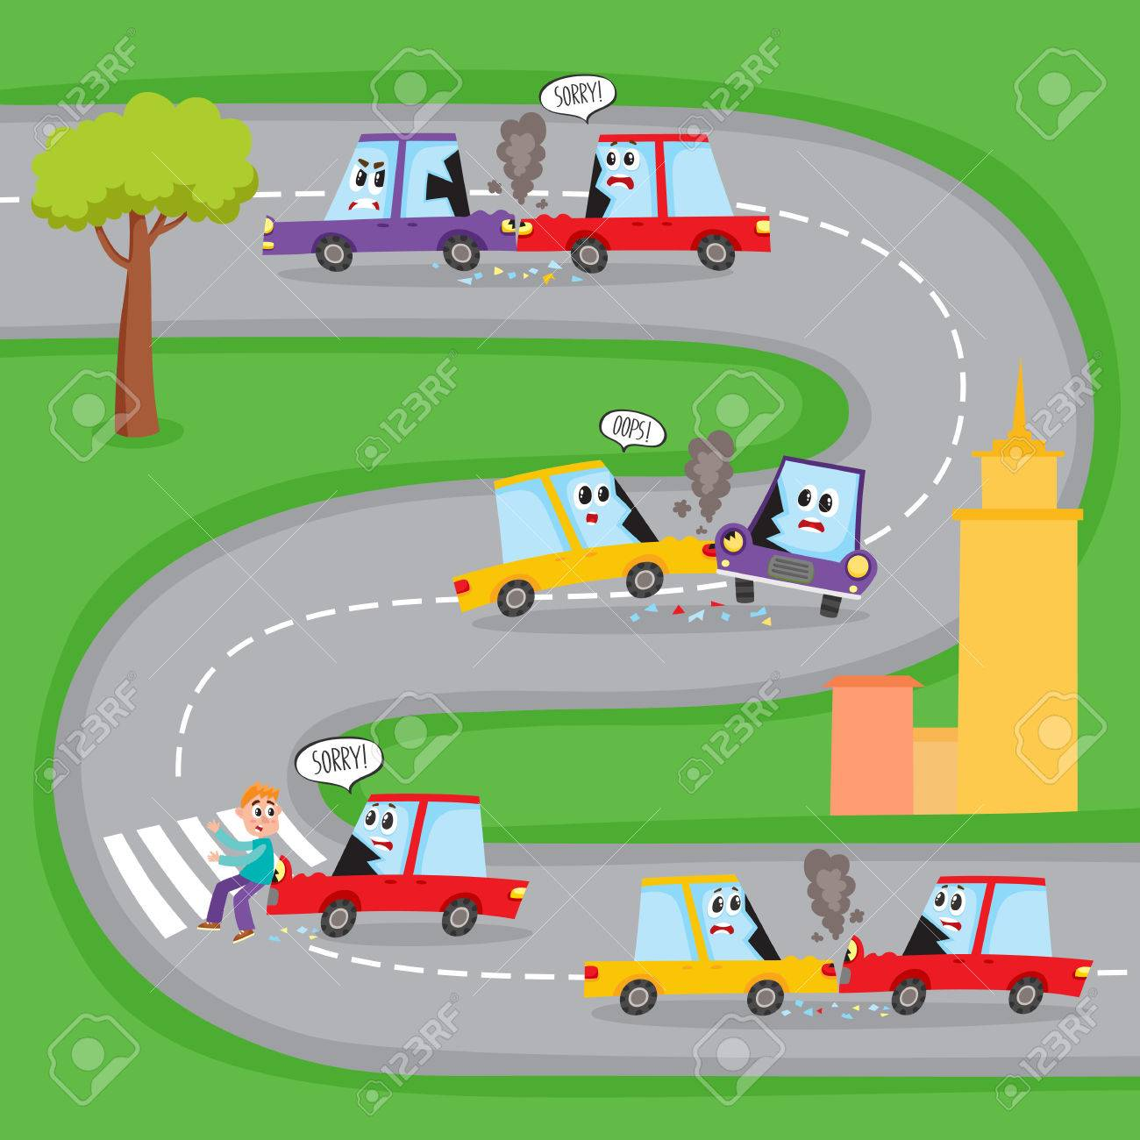

Slide 13
DSRC standards

Slide 14
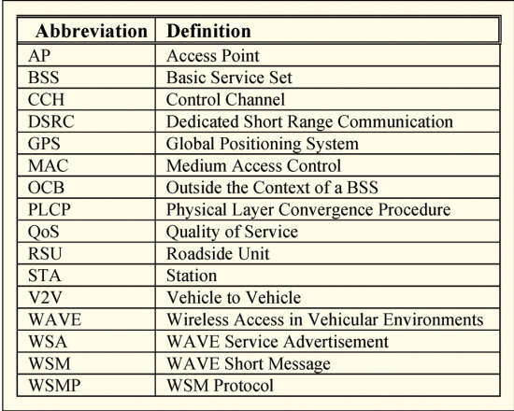
V2V-Interoperability project focuses on whether the emerging standards are;
Clear
Comprehensive
enough so that independent implementations will be able to communicate.

Slide 15
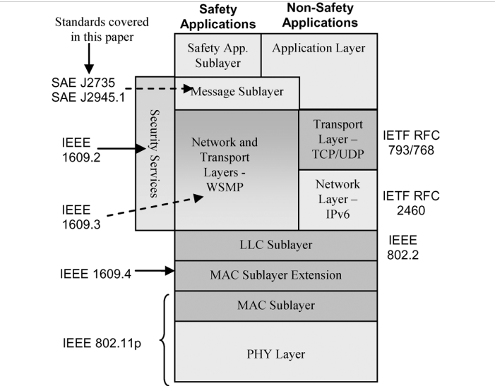
DSRC STANDARTS
1609.4 -> Channel Switching.
1609.2 -> Security Services.
User Datagram Protocol (UDP)
Transmission Control Protocol (TCP).
Internet Protocol version 6 (IPv6)

Slide 16
Physical layer standards

Slide 17
RF signals
The physical layer standards for DSRC specify the characteristics of the RF signals that are used for transmission and reception. These characteristics include the frequency, bandwidth, power, and modulation schemes.

Slide 18
802.11 / 802.11p
ASTM E2213-03 -> 802.11 / 802.11p
802.11 / 802.11p
PMD (Physical Medium Dependent Sublayer.):
Interfaces directly with the wireless medium.
PLCP (Physical Layer Convergence Procedure Sublayer. ) :
Mapping between the MAC frame and the basic PHY layer data unit.

Slide 19
OFDM Physical Medium Dependent (PMD) Function
CHANELS
OFDM protocol used in 802.11 is defined for three channel widths: 20, 10, and 5 MHz.
DSRC -> 10 MHz channel.

Slide 20
OFDM Physical Medium Dependent (PMD) Function
ENCODING / DECODING
Four modulation techniques are available for use on a subcarrier, each of which corresponds to a different number of bits encoded per subcarrier symbol.
Forward error correction (FEC) coding is applied to the user bits, which reduces the effective user bit rate but also improves the probability of successful decoding.

Slide 21
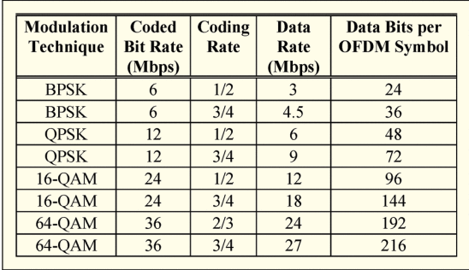
Data Rate Options in a DSRC 10 MHz OFDM Channel

Slide 22
OFDM Physical Medium Dependent (PMD) Function
PMD TRANSMITTER
OFDM modulation;
Inverse Fast Fourier Transform calculation
Guard Interval (cyclic prefix) insertion,
Wave shape filtering,
RF modulation,
Power amplification.

Slide 23
OFDM Physical Medium Dependent (PMD) Function
PMD TRANSMITTER
PCLP requests the PMD to transmit a frame.
Frame included symbol data rate and transport power information.
PMD process the data.

Slide 24
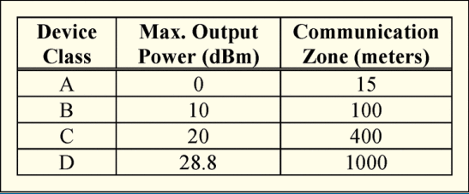
FCC Device ClassIfIcatIon ACCORDING TO MAXIMUM TRANSPORT POWER
V2V -> C

Slide 25
OFDM Physical Medium Dependent (PMD) Function
PMD RECEIVER
The PMD receiver performs the demodulation steps;
Automatic gain control (AGC)
Clock recovery
RF demodulation
Guard interval removal
Fast Fourier Transform

Slide 26
ReceIver performance
OFDM Physical Medium Dependent (PMD) Function
PMD RECEIVER
Minimum Sensitivity -> is defined as the minimum absolute signal energy for which a reference 1000 byte packet must be correctly received at least 90% of the time.
Channel Rejection -> indication of a receiver's ability to filter out energy that is outside the 10 MHz channel of interest.
According to IEEE 802.11;
Adjacent channel rejection (ACR)
Nonadjacent channel rejection (NACR)

Slide 27
DSRC SPECTRUM
OFDM Physical Medium Dependent (PMD) Function
The DSRC is achieved over reserved radio spectrum bands, which changes region to region such as North America, Europe, and Japan.
Allocated by different authorities in said regions:
U.S. FCC and Industry Canada in North America
The Electronic Communications Committee of the European Conference of Postal and Telecommunications Administrations (CEPT) in Europe
The Ministry of Internal Affairs and Communications (MIC) in Japan.

Slide 28
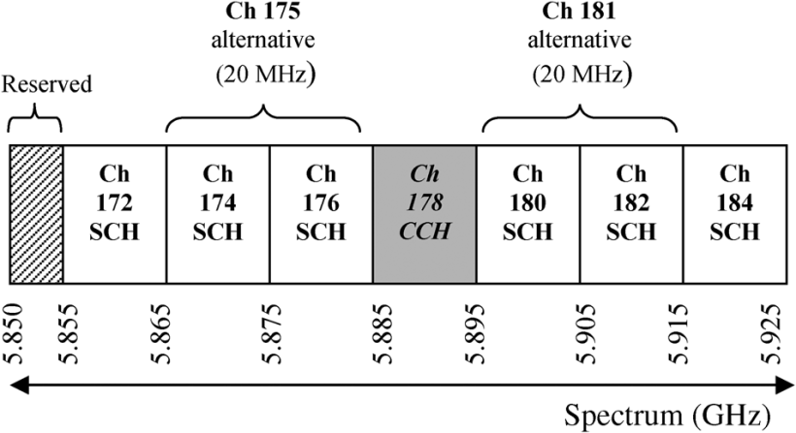
Representation of allocated spectrum by the FCC for North America

Slide 29
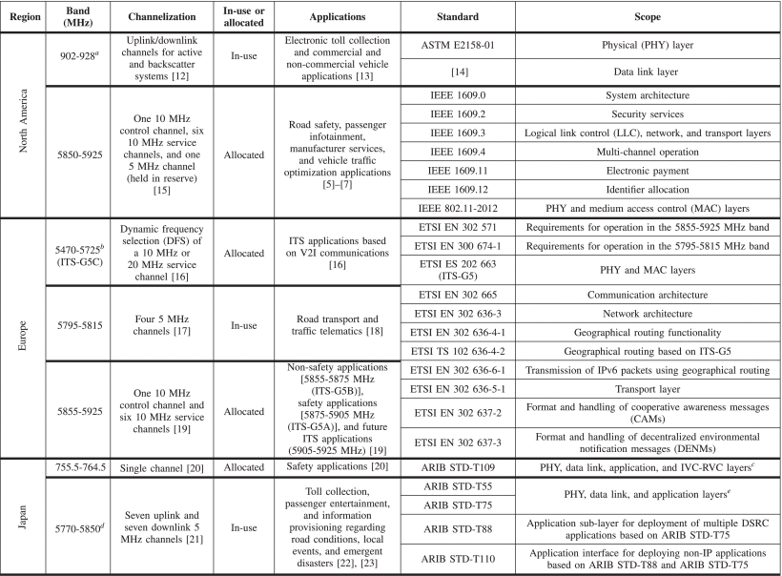
DSRC SPECTRUM
OFDM Physical Medium Dependent (PMD) Function
Some DSRC bands are currently deployed for applications such as electronic toll collection, e.g.
While the rest of the DSRC allocated spectrum bands are currently not in use.

Slide 30
OFDM Physical Layer Convergence Procedure (PLCP) Function
Transmitter -> The PLCP function is to process the bytes in a MAC frame so that they can be transformed into OFDM symbols for transmission over the air by the PMD.
PLCP adds PHY layer overhead to the MAC frame to create the PHY Protocol Data Unit (PPDU)
Receiver -> The PLCP performs essentially the inverse function to extract a MAC frame from the PPDU(Physical Protocol Data Unit Format).

Slide 31
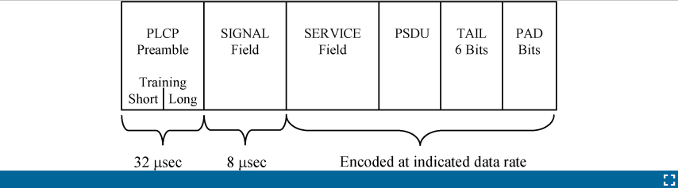
Physical Protocol Data Unit format
Preamble-> synchronization
A receiver operating on a 10 MHz channel must classify the channel as “busy” within 8 μsec after detecting the start of the Preamble
Signal Field-> conveys the data rate and frame length.
Preamble and SIGNAL are sent at a predetermined rate, more specifically at the lowest rate in Table 3,
The lowest data rate is specified to maximize the probability that a receiver will successfully decode that portion of the frame.
Service and TAIL Field-> facilitate bit scrambling.
The PAD field -> ensures that the final OFDM symbol encodes the proper number of user bits from Table 3.

Slide 32
DATA layer standards

Slide 33
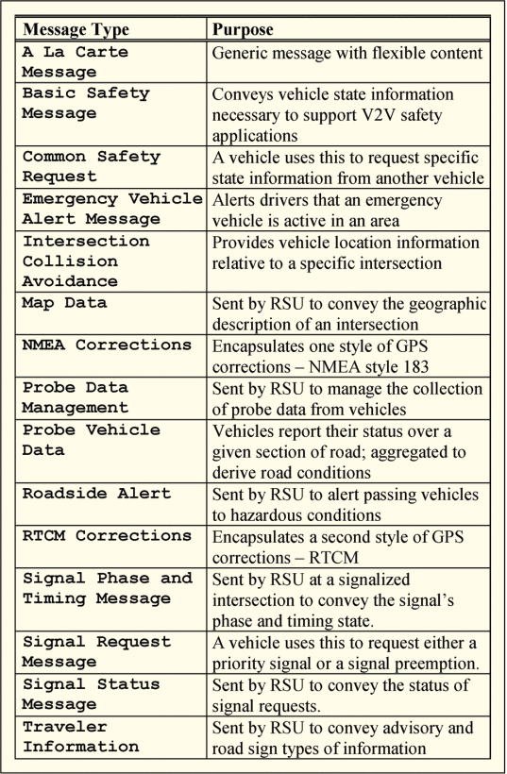
DSRC Message Set
There are fifteen message types that are defined in the SAE J2735 standard.
The Basic Safety Message (BSM) is perhaps the most important message in the J2735 standard. It conveys core state information about the sending vehicle, namely its position, dynamics, system status, and size. It also has the flexibility to convey additional information as needed.
The BSM has two parts. Part I includes critical state information that must be sent in every BSM. Part II is an optional area where additional data elements and frames can be included.

Slide 34
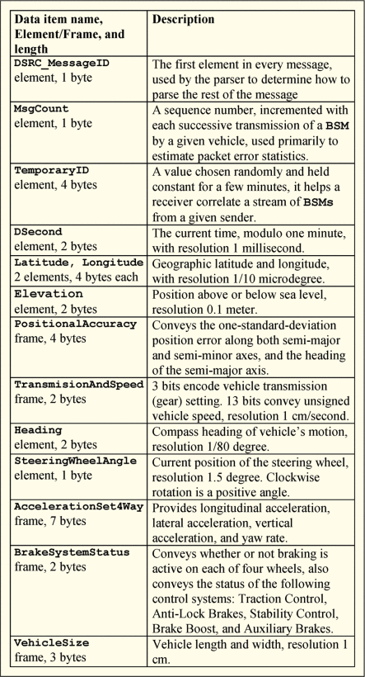
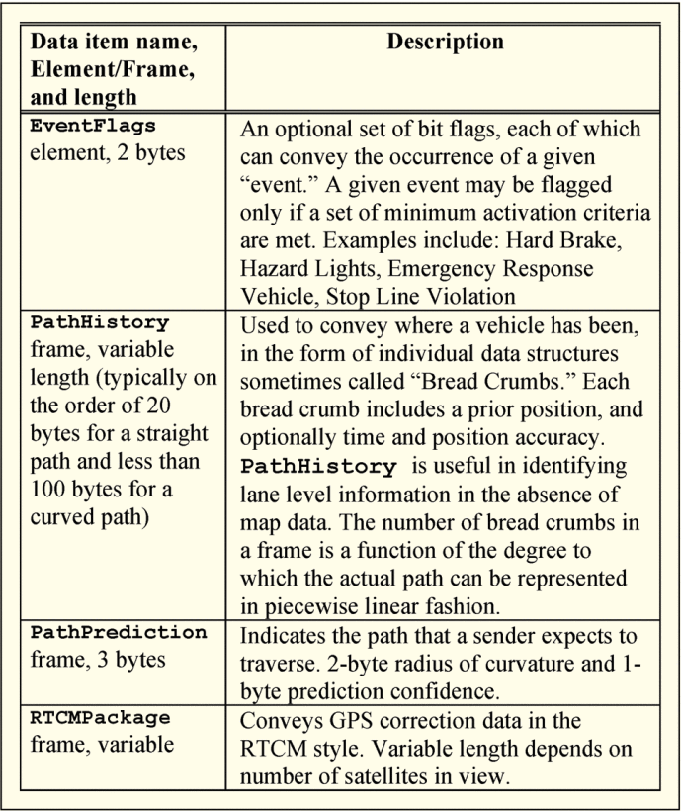
Content of the BSM Part I
Content of the BSM Part II
There are four data items that are discussed for inclusion in Part II of the BSM. These are collected in a data frame called “VehicleSafetyExtension”. A given VehicleSafetyExtension frame may be composed of any combination of the four data items shown.

Slide 35
Procedures for transmission and reception
The data layer standards specify the procedures for transmitting and receiving messages over DSRC. These procedures define the rules for initiating and terminating communication, as well as the protocols for ensuring the reliability and integrity of the transmitted information.

Slide 36
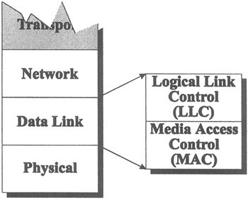
The DSRC Data Link Layer
The LLC sub-layer has been adapted from the IEEE 8088.2 specifications for connection-less and connection-oriented services.
The MAC sub-layer caters for efficient contention mechanisms to avoid and resolve data collisions in multi-lane environments.

Slide 37
The standardized DSRC LLC protocol
The DSRC Logical Link Control (LLC) protocol is responsible for controlling the flow of data between two devices over the DSRC communication link.
It is a data link layer protocol in the OSI model and is responsible for establishing, maintaining, and terminating logical connections between devices.

Slide 38
The standardized DSRC LLC protocol
The LLC protocol provides several key functions, including:
Connection establishment
Flow control
Error detection and correction
Sequence numbering
The DSRC LLC protocol is an important part of the overall DSRC communication system, and it plays a key role in enabling reliable and efficient communication between vehicles and transportation infrastructure.

Slide 39
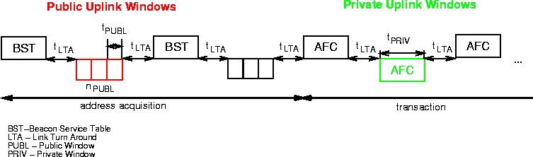
The standardized DSRC MAC protocol
The DSRC MAC protocol is based on half-duplex TDMA.
The beacon (as primary station):
Public Windows -> consists of time slots (public slots), which may be accessed by every vehicle within the communication zone.
Beacon Service Table, holds information about the valid application and protocol parameters. public windows are offered periodically by the beacon to newly arriving vehicles (address acquisition or connection phase).
Private Windows -> allocation reserves a time period for one specific vehicle and therefore protects it against data collisions after the address of a vehicle is known (transaction phase).

Slide 40
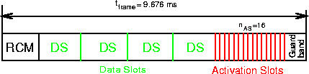
The Open Road Frame solution
Asynchronous DSRC MAC protocol, the TDMA protocol proposed for the ITS communication architecture is based on Open-Road Frame;
Reader Control Message (RCM),
Several Data Slots (DS)
Number of Activation Slots (AS).
The activation slots are used for the transmission of the ID of newly arriving vehicles.
The data slots may be used for down-link transmissions or are reserved by the beacon for up-link transmissions (similar to private windows).
Reading the RCM, the vehicles get to know the assignment of down-link and up-link slots.
The DSRC MAC protocol can also be used in a synchronous mode by setting the BST retransmission intervals to a fixed length.

Slide 41
DSRC applications

Slide 42

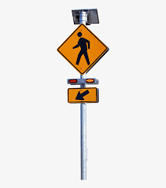
Traffic control signals
DSRC can be used to transmit traffic control signals, such as traffic lights and stop signs, to vehicles. This can improve the safety and efficiency of traffic flow by allowing vehicles to respond to the signals in real-time.

Slide 43
V2V
V2V communication allows vehicles to exchange information about their location, speed, and direction of travel with other nearby vehicles. This can be used to improve traffic flow and safety, for example by warning drivers of potential collisions or alerting them to road hazards.

Slide 44
V2I
V2I communication involves vehicles communicating with infrastructure such as traffic lights or road signs. This can allow vehicles to receive real-time traffic updates or to adjust their speed based on the state of traffic lights. V2I communication can also be used to improve traffic flow by adjusting the timing of traffic lights or providing information about available parking spaces.

Slide 45
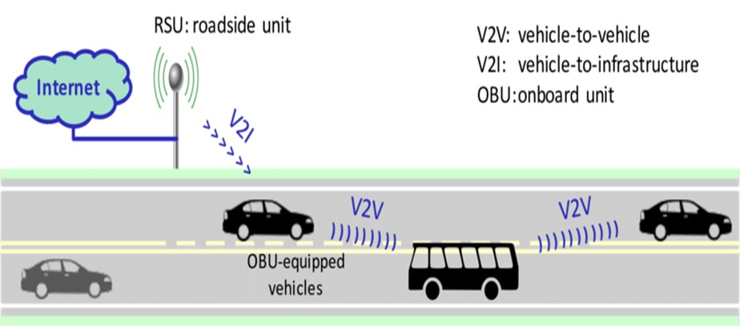
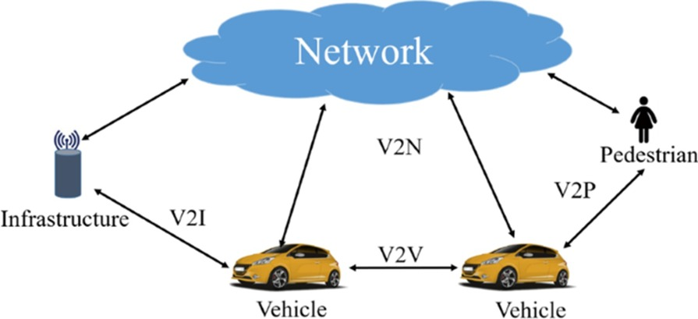

Slide 46
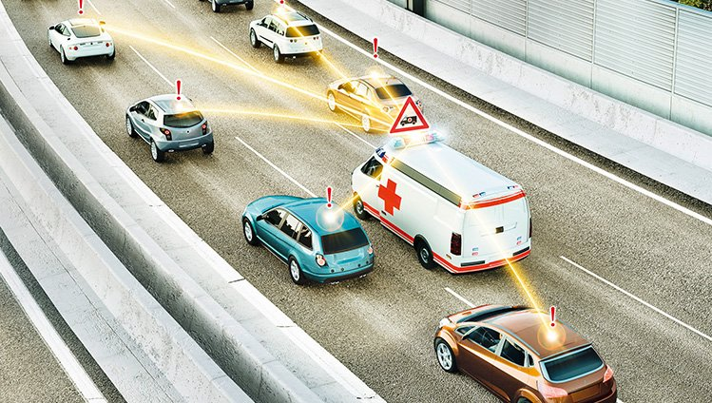
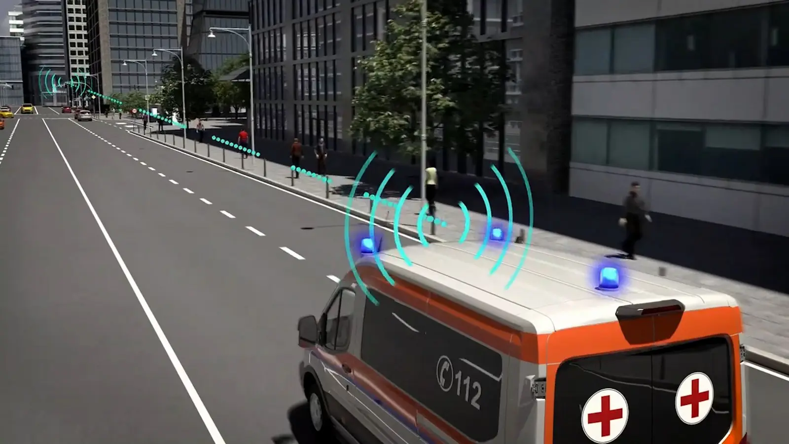
Emergency vehicle warnings
DSRC can be used to transmit warnings about the presence and location of emergency vehicles to other vehicles in the vicinity. This can help to alert other drivers and improve the safety of emergency responders.

Slide 47
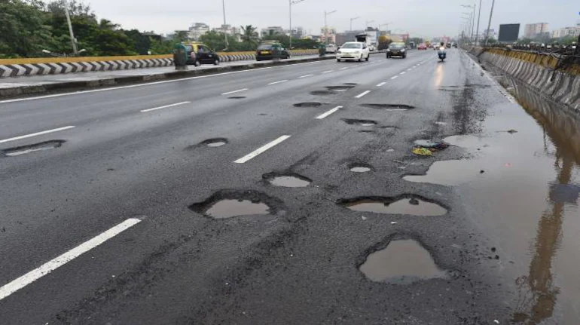
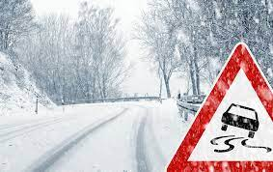
Weather and road condition reports
DSRC can be used to transmit real-time information about the weather and road conditions to vehicles. This can help drivers to make informed decisions about their route and speed, and can improve the safety of travel.

Slide 48
Advantages of DSRC

Slide 49

Improved safety and efficiency
DSRC can provide a highly secure communication network in V2X technology. Driver’s privacy is protected with this feature.

Slide 50
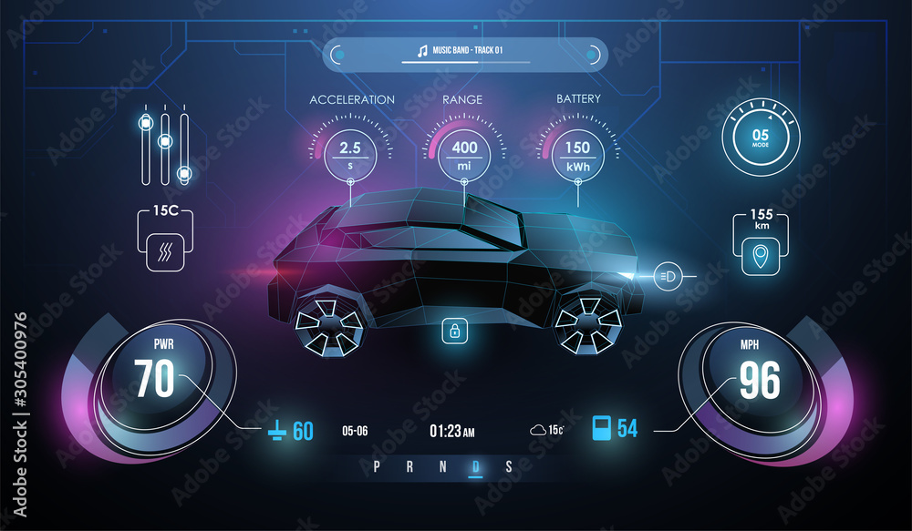
Exchange of vehicle location, speed, and direction information
Allows to detect, determinate and evaluate dangerous situations even without vehicles being visually noticed.
DSRC can provide high-speed communication even when there are obstacles and is optimized for working in bad weather conditions.

Slide 51
Challenges and limitations of DSRC

Slide 52
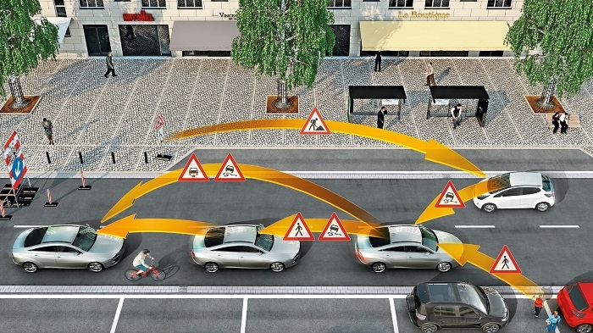

Cost of equipment and infrastructure
Implementing DSRC requires the installation of equipment and infrastructure, which can be expensive.
In general, implementing a DSRC infrastructure will require the deployment of a network of roadside units (RSUs) along the roads being covered. These units are equipped with antennas and other hardware that allow them to communicate with vehicles equipped with DSRC technology.

Slide 53
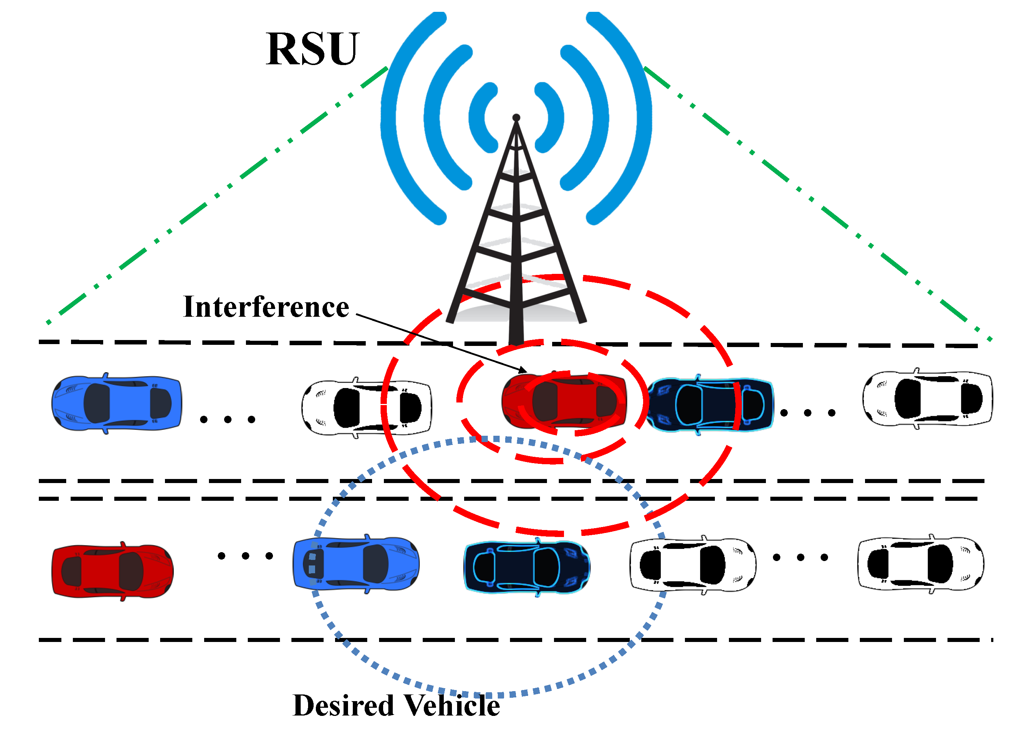
Interference with other wireless technologies
DSRC operates in a crowded frequency band and may be subject to interference from other wireless technologies.
Its short range (~1000 m) limits the chance of interference from distant sources

Slide 54

Privacy concerns
The exchange of information over DSRC may raise privacy concerns, particularly if the information includes personal or sensitive data.
DSRC is protected by the Federal Communications Commission (FCC) for transportation applications

Slide 55
Future of DSRC

Slide 56
HOW TO IMPROVE
Despite the collaborative efforts from governments, academic institutions, industrial organizations, and standardization bodies in the research and development (R&D) of DSRC, the technology still suffers from some limitations in supporting V2X applications.
The concerns in pure-DSRC V2X communication solutions have raised the interest in the research community to investigate the ability of off-the-shelf cellular technologies [e.g., Long-Term Evolution (LTE)] to support reliable V2X communications for different applications. Despite these advantages, there are several challenges that limit the ability of cellular technology to support reliable V2X communications on its own.

Slide 57
HOW TO IMPROVE
Due to the limitations of using a single V2X technology to support efficient and reliable V2X communications, an inclusion of both DSRC and cellular technologies is more viable. Hybrid solutions that exploit the benefits of both DSRC and cellular technologies have been proposed for vehicular communications. The benefits of making use of the two technologies are as follows. A cellular network can:
Act as a backup for vehicular data when V2V multihop connections are shattered in a sparse network
Act as an access network to the Internet
Backbone network for control message dissemination.

Slide 58
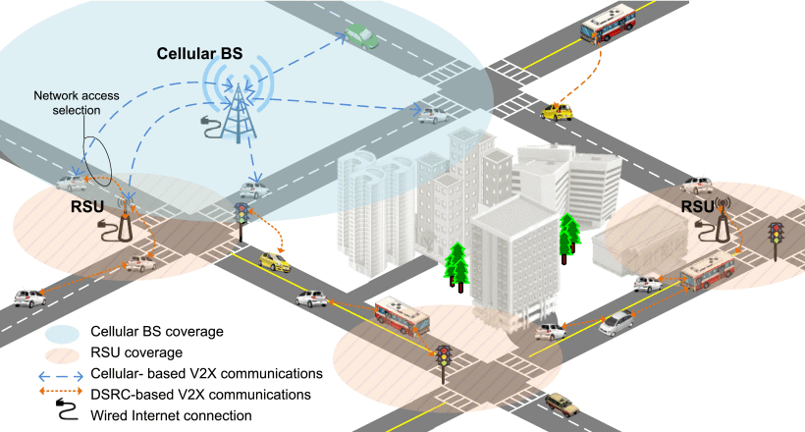

Slide 59
THANK YOU Mehmet alperen ölçer 20011023 Şevval bulburu 19011038 semih erken 19011503 affan ahmet bedri topal 19011504 Emirhan karadeniz 18011041

Slide 60
M. Kady, M. Ristenblatt. An Evolutionary IVHS Communication Architecture. In Vehicle Navigation and Information Systems Conference, Ottawa, Canada, IEEE, October 1993.
CEN TC 278 WG9 SG.L2. Road Traffic and Transport Telematics - Dedicated Short-Range Communications - DSRC Data Link Layer: Medium Access and Logical Link Control. Draft prENV 278/9/#64, CEN, European Committee for Standardisation, Central Secretariat, Brussels, March 1995.
https://ieeexplore.ieee.org/abstract/document/5888501?casa_token=6zWzZIGbz1QAAAAA:FeVKvcaLaCB0eSWSVfo9O_KiQcVcTAx2lAdnPn5fQc2LWEWADcVY19waBduVZW_4JBZfiokAKg
J. B. Kenney, "Dedicated Short-Range Communications (DSRC) Standards in the United States," in Proceedings of the IEEE, vol. 99, no. 7, pp. 1162-1182, July 2011, doi: 10.1109/JPROC.2011.2132790.
K. Abboud, H. A. Omar and W. Zhuang, "Interworking of DSRC and Cellular Network Technologies for V2X Communications: A Survey," in IEEE Transactions on Vehicular Technology, vol. 65, no. 12, pp. 9457-9470, Dec. 2016, doi: 10.1109/TVT.2016.2591558.

